Slide 1

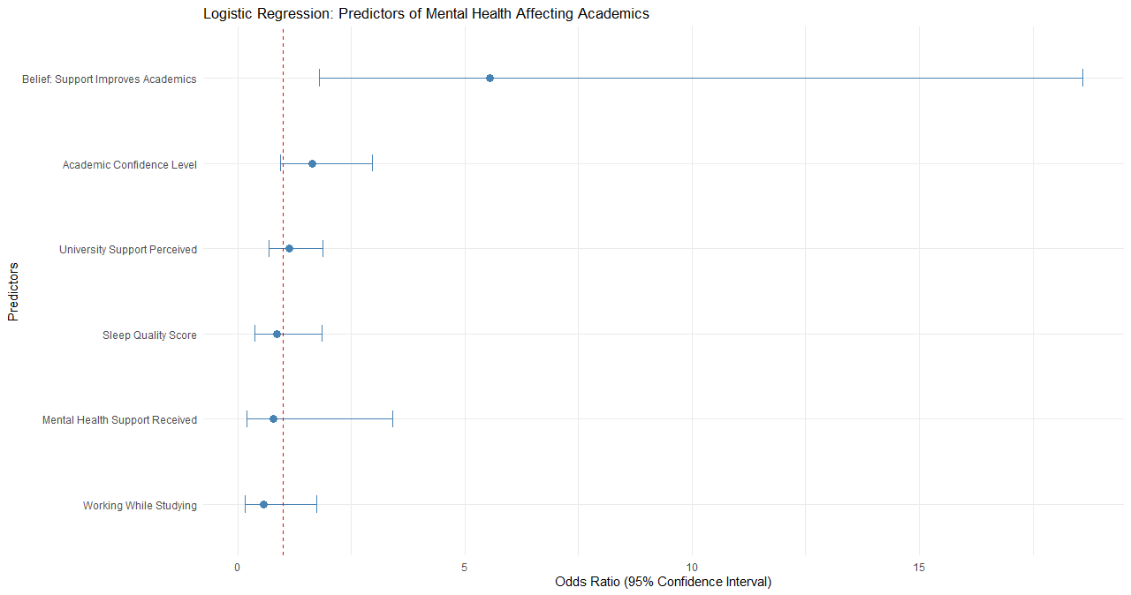
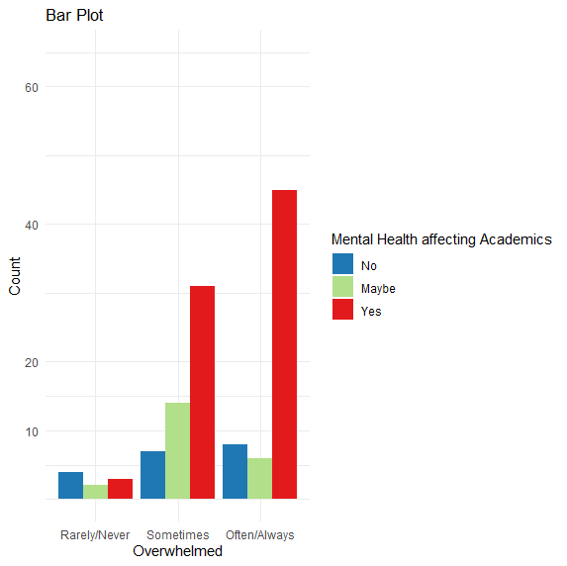
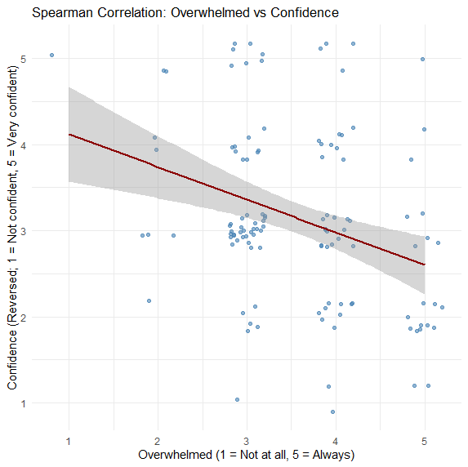
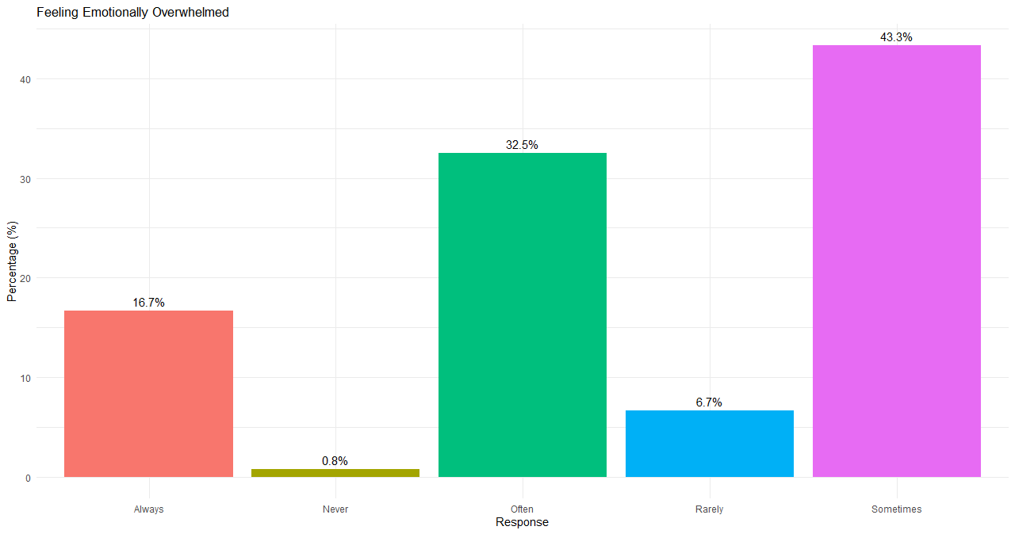
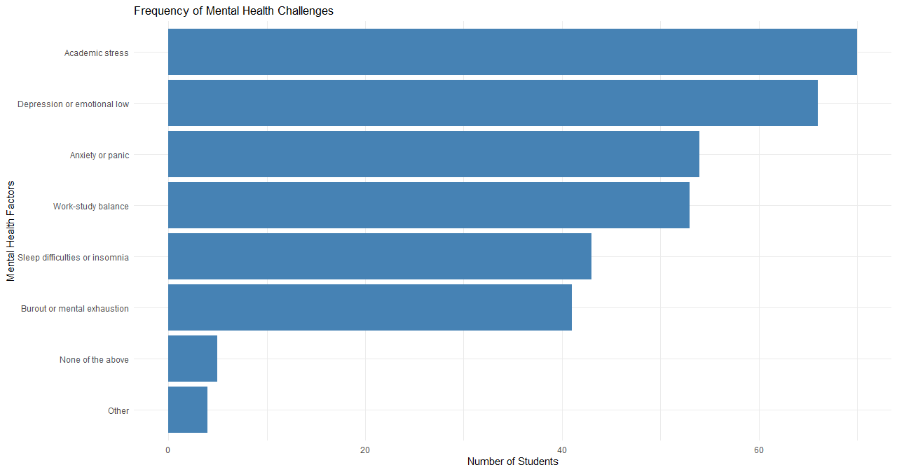
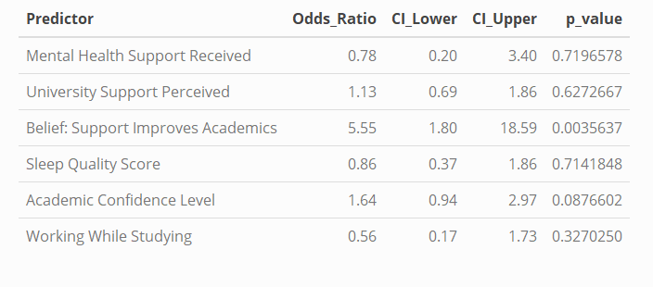
Does Mental Health Affect Academic Performance Among
University Students?
Sreya Josey , MA23w1-M ,Mtk Nr: 83852 e-mail: sjosey@hs-mittweid.de
Department of Applied Mathematics, Hochschule Mittweida University of Applied
Supervised by Prof. Dr. rer. nat. Dr.-Ing. Habil. Florian Zaussinger
:
Abstract
This study investigates the impact of mental health on academic performance among university students. A survey of 120 University students was conducted to examine the relationship between emotional well-being and academic difficulties using statistical analyses. The findings highlight significant mental health factors that influence academic outcomes and emphasize the need for enhanced support systems within universities.
Methods
The study used a quantitative approach with data collected anonymously via a Google Forms survey, with participants informed of confidentiality and voluntary participation. A total of 120 students from bachelor’s, master’s, and PhD programs participated, representing a diverse range of age groups, genders, and nationalities. The survey gathered data on mental health experiences and academic impact.
Statistical Analysis:
Chi-square and Fisher’s exact tests assessed links between mental health impact and feeling overwhelmed.
Spearman correlation examined relationships between overwhelm and confidence.
Regression predicted mental health impact using factors such as support seeking, perception of university support, belief in improvement with better support, sleep, work status, and confidence.
Results
Prevalence-65.8% reported mental health affects academics; 49.2% feel overwhelmed often/always.
Students who feel overwhelmed are more likely to report academic impact (Chi-square p = 0.0185; Fisher’s Exact p = 0.015 (used due to low expected cell counts).
Negative correlation between feeling overwhelmed and academic confidence (Spearman’s rho = -0.31, p = 0.0055).
Logistic Regression showed that the belief that support improves academics was a significant predictor of reporting mental health impact; academic confidence was near-significant, while other factors were not significant.
Introduction
Mental health challenges among university students have become an increasingly important issue worldwide. Academic pressure, emotional distress, and lifestyle changes during university years contribute to elevated levels of stress, anxiety, and depression. These difficulties can adversely affect academic performance, leading to lower performance, missed classes, and delayed tasks. Although mental health is widely recognized as critical to student success, there is a lack of quantitative research clearly defining how mental health challenges impact academic outcomes across diverse student populations. This study aims to fill this gap using survey data and statistical analysis.
Main Objectives:
Determine the prevalence of mental health challenges among university students.
Investigate whether mental health difficulties affect academic performance.
Figure 6: Figure 6: Regression – Predictors of Mental Health Affecting Academics
Figure 3: Mental Health Impact vs. Feeling Overwhelmed.
Figure 1: Percentage of Students Feeling Emotionally Overwhelmed.
source: study.com
Figure 4: Spearman Correlation :Overwhelm vs. Confidence
Figure 2: Frequency of Different Mental Health Challenges Reported by Students.
Discussion
Mental health strongly affects academic performance; students who feel overwhelmed report lower confidence and more academic difficulties. The belief that support improves academics was the strongest predictor of perceived academic impact; factors like university support or sleep were less influential. Clustering revealed a high-risk group with poor outcomes, highlighting the need for targeted support.
Universities should not only provide better mental health services but also promote awareness and build confidence in their effectiveness to positively influence academic outcomes.
source: EGU blogs
source: study.com
References
[1] Eisenberg, Daniel, Ezra Golberstein, and Justin B. Hunt. "Mental health and academic success in college." The BE journal of economic analysis & policy 9.1 (2009).
[2] Eisenberg, Daniel, et al. "Prevalence and correlates of depression, anxiety, and suicidality among university students." American journal of orthopsychiatry 77.4 (2007): 534-542.
Table 1: Logistic Regression Results

